Slide 1

332:479 Concepts in VLSI
Design
Lecture 10
Wires
David Harris and Mike Bushnell
Harvey Mudd College and Rutgers University
Spring 2004

Slide 2
Outline
Introduction
Wire Resistance
Wire Capacitance
Wire RC Delay
Wire Engineering
Repeaters
Summary
Material from: CMOS VLSI Design
By Neil E. Weste and David Harris

Slide 3
Digital CMOS VLSI
Levels of simulation:
Behavioral and Register Transfer – tells you whether hardware correctly performs, says nothing about delay
Logic – May tell you whether voltage levels are correct, says very little about delay
Switch – Almost always gives accurate voltages, delays are inaccurate
Analog – Gives very accurate signal voltages, currents, delays, and power
  Requires exacting characterization of R, C, L components
  Requires correct analog transistor models
  Uses large amounts of computer time

Slide 4
Introduction
Chips are mostly made of wires called interconnect
  In stick diagram, wires set size
  Transistors are little things under the wires
  Many layers of wires
Wires are as important as transistors
  Speed
  Power
  Noise
Alternating layers run orthogonally

Slide 5
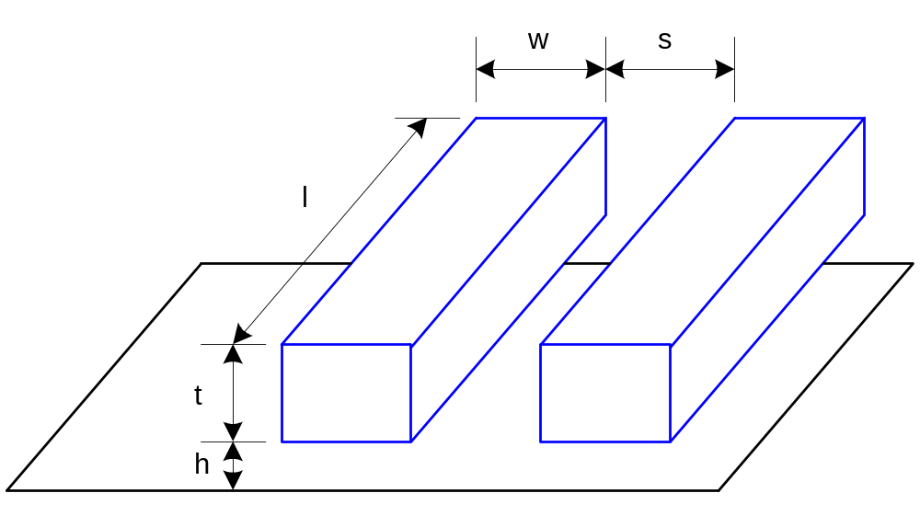
Wire Geometry
Pitch = w + s
Aspect ratio: AR = t/w
  Old processes had AR << 1
  Modern processes have AR ≈ 2
    Pack in many skinny wires

Slide 6
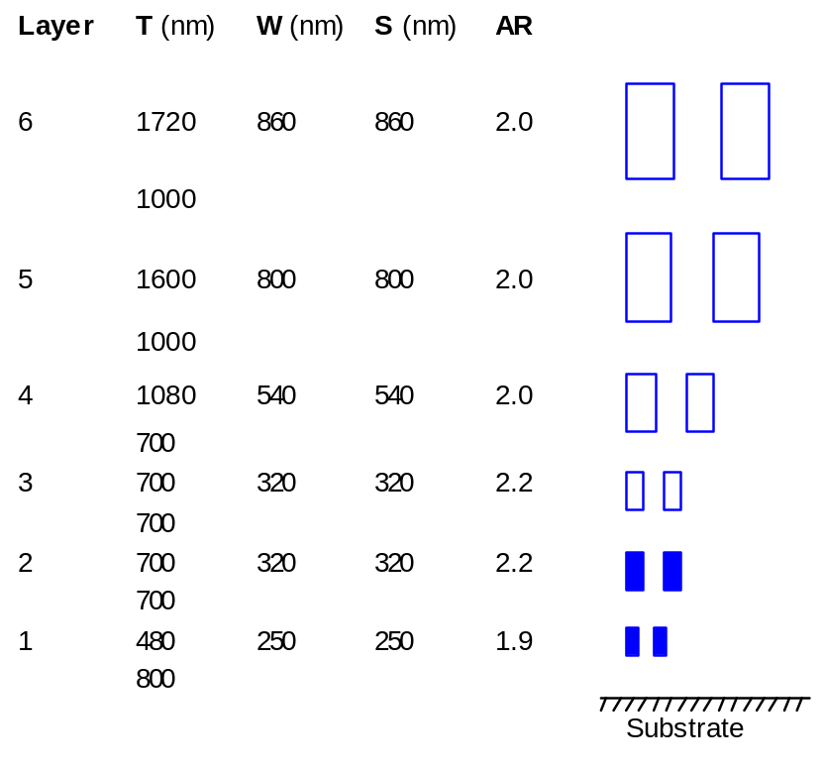
Layer Stack
AMI 0.6 μm process has 3 metal layers
Modern processes use 6-10+ metal layers
Example:
  Intel 180 nm process
M1: thin, narrow (< 3λ)
  High density cells
M2-M4: thicker
  For longer wires
M5-M6: thickest
  For V_{DD}, GND, clk

Slide 7

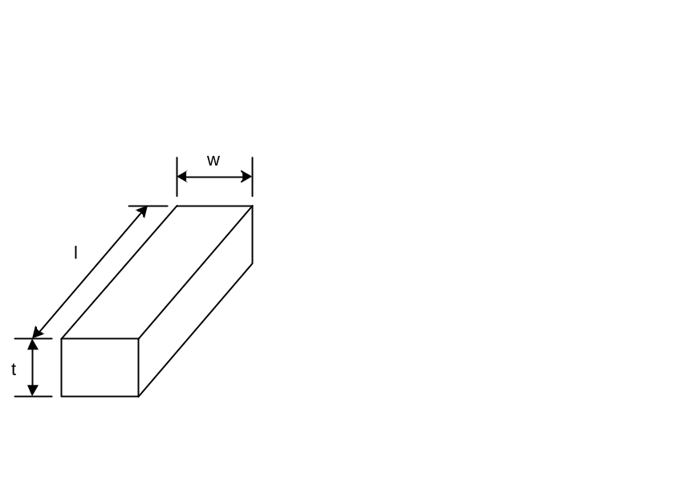
Wire Resistance
ρ = resistivity (Ω*m)

Slide 8
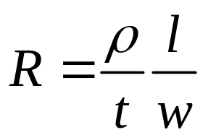
Wire Resistance
ρ = resistivity (Ω*m)

Slide 9
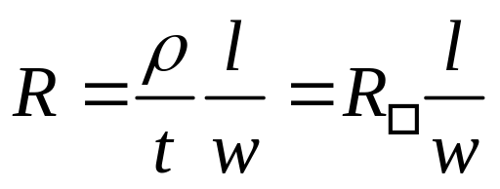
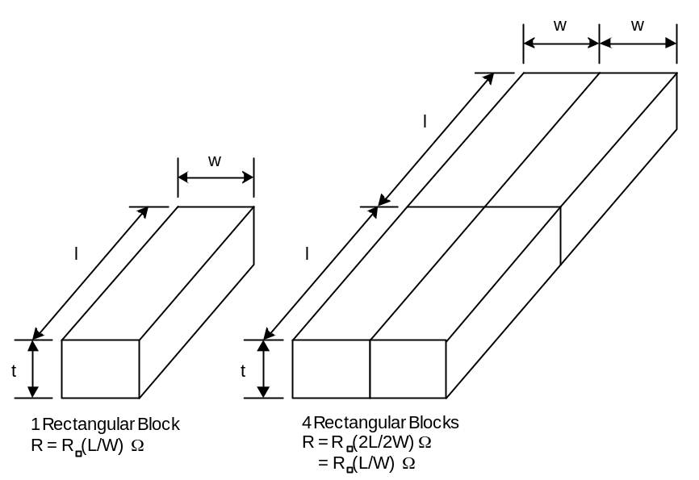
Wire Resistance
ρ = resistivity (Ω*m)
R□ = sheet resistance (Ω/□)
  □ is a dimensionless unit(!)
Count number of squares
  R = R□ * (# of squares)

Slide 10
Choice of Metals
Until 180 nm generation, most wires were aluminum
Modern processes often use copper
  Cu atoms diffuse into silicon and damage FETs
  Must be surrounded by a diffusion barrier
Metal | Bulk resistivity (μΩ*cm)
Silver (Ag) | 1.6
Copper (Cu) | 1.7
Gold (Au) | 2.2
Aluminum (Al) | 2.8
Tungsten (W) | 5.3
Molybdenum (Mo) | 5.3

Slide 11
Resistance
Upper layer metal – reduced R_{s} because it is thicker
But, a DRAM process may have thinner metal to improve yield with fewer topology jumps
NOTE: ρ for metal of given t is known, but for poly or diffusion it changes radically with implantation
Must know the process parameters to get ρ

Slide 12
Sheet Resistance
Typical sheet resistances in 180 nm process
Layer | Sheet Resistance (Ω/□)
Diffusion (silicided) | 3-10
Diffusion (no silicide) | 50-200
Polysilicon (silicided) | 3-10
Polysilicon (no silicide) | 50-400
Metal1 | 0.08
Metal2 | 0.05
Metal3 | 0.05
Metal4 | 0.03
Metal5 | 0.02
Metal6 | 0.02

Slide 13
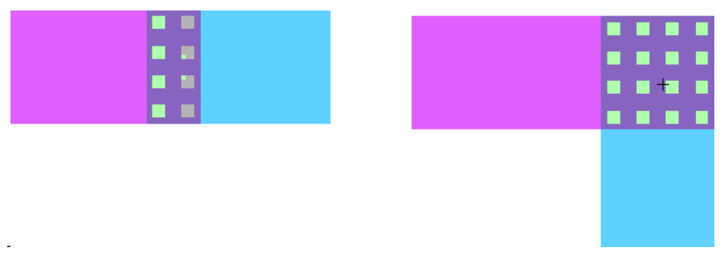
Contact Resistance
Contacts and vias also have 2-20 Ω
Use many contacts for lower R
  Many small contacts for current crowding around periphery

Slide 14
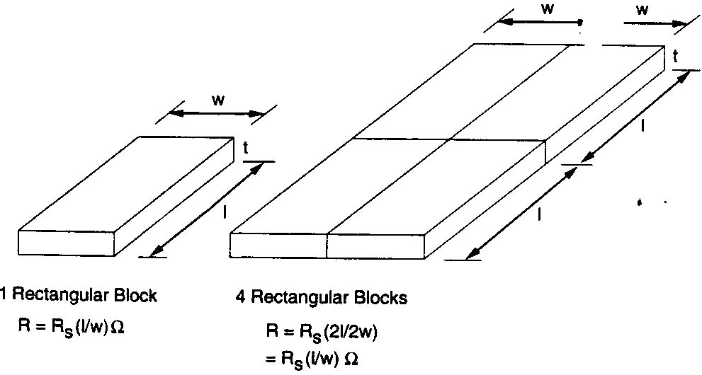
Uniform Conductor Slab Resistance

Slide 15
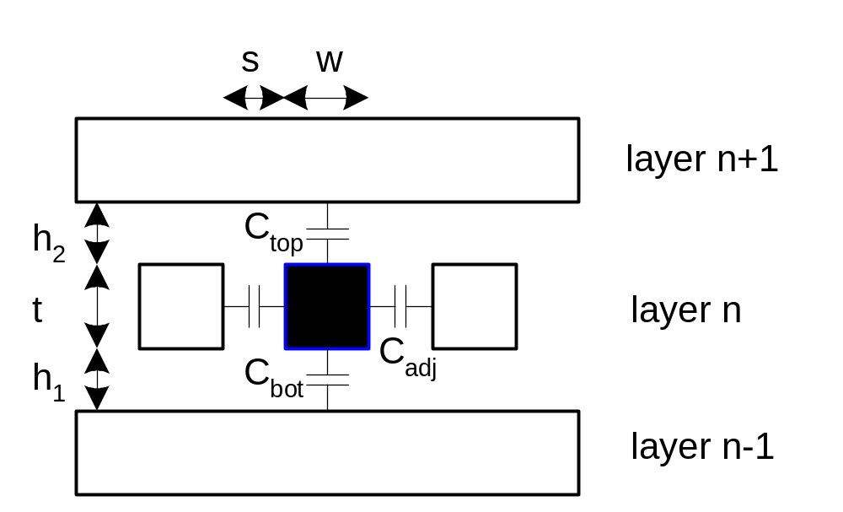
Wire Capacitance
Wire has capacitance per unit length
  To neighbors
  To layers above and below
C_{total} = C_{top} + C_{bot} + 2C_{adj}

Slide 16
Capacitance Trends
Parallel plate equation: C = εA/d
  Wires are not parallel plates, but obey trends
  Increasing area (W, t) increases capacitance
  Increasing distance (s, h) decreases capacitance
Dielectric constant
  ε = kε₀
ε₀ = 8.85 x 10⁻¹⁴ F/cm
k = 3.9 for SiO₂
Processes are starting to use low-k dielectrics
  k ≈ 3 (or less) as dielectrics use air pockets

Slide 17
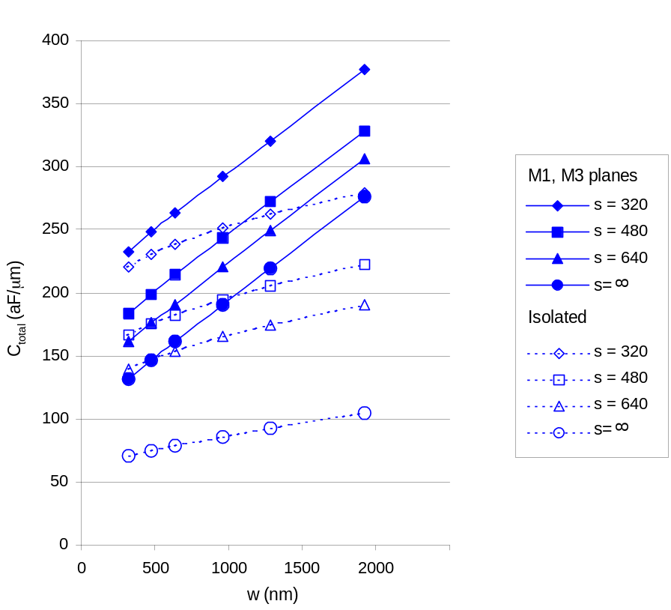
M2 Capacitance Data
Typical wires have ~ 0.2 fF/μm
  Compare to 2 fF/μm for gate capacitance

Slide 18
Diffusion & Polysilicon
Diffusion capacitance is very high (about 2 fF/μm)
  Comparable to gate capacitance
  Diffusion also has high resistance
  Avoid using diffusion runners for wires!
Polysilicon has lower C but high R
  Use for transistor gates
  Occasionally for very short wires between gates

Slide 19
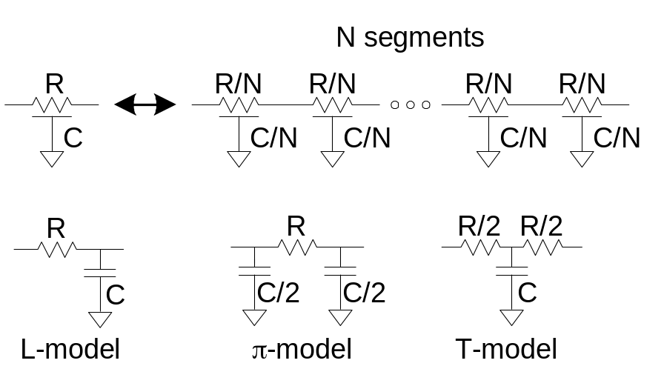
Lumped Element Models
Wires are a distributed system
  Approximate with lumped element models
3-segment π-model is accurate to 3% in simulation
L-model needs 100 segments for same accuracy!
Use single segment π-model for Elmore delay

Slide 20
Example
Metal2 wire in 180 nm process
  5 mm long
  0.32 μm wide
Construct a 3-segment π-model
  R□ =
  C_{permicron} =

Slide 21
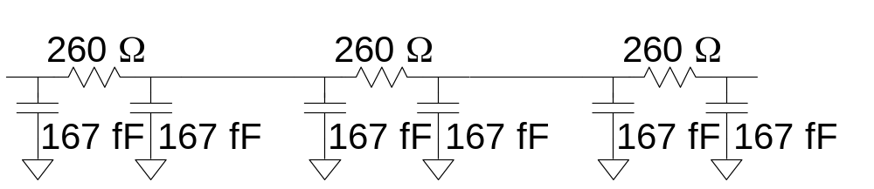
Example
Metal2 wire in 180 nm process
  5 mm long
  0.32 μm wide
Construct a 3-segment π-model
  R□ = 0.05 Ω/□ => R = 781 Ω
  C_{permicron} = 0.2 fF/μm => C = 1 pF

Slide 22
Wire RC Delay
Estimate the delay of a 10x inverter driving a 2x inverter at the end of the 5mm wire from the previous example.
  R = 2.5 kΩ*μm for gates
  Unit inverter: 0.36 μm nMOS, 0.72 μm pMOS
  t_{pd} =

Slide 23
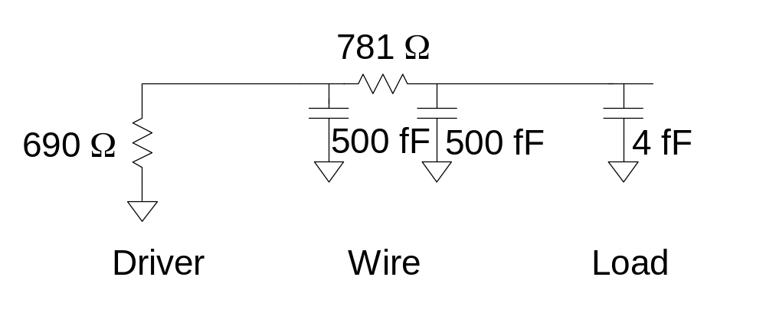
Wire RC Delay
Estimate the delay of a 10x inverter driving a 2x inverter at the end of the 5mm wire from the previous example.
  R = 2.5 kΩ*μm for gates
  Unit inverter: 0.36 μm nMOS, 0.72 μm pMOS
  t_{pd} = 1.1 ns

Slide 24
Noise Implications
So what if we have noise?
If the noise is less than the noise margin, nothing happens
Static CMOS logic will eventually settle to correct output even if disturbed by large noise spikes
  But glitches cause extra delay
  Also cause extra power from false transitions
Dynamic logic never recovers from glitches
Memories and other sensitive circuits also can produce the wrong answer

Slide 25
Wire Engineering
Goal: achieve delay, area, power goals with acceptable noise
Degrees of freedom:

Slide 26
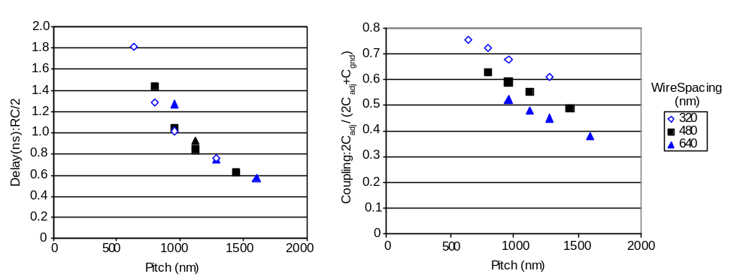
Wire Engineering
Goal: achieve delay, area, power goals with acceptable noise
Degrees of freedom:
  Width
  Spacing

Slide 27
Wire Engineering
Goal: achieve delay, area, power goals with acceptable noise
Degrees of freedom:
  Width
  Spacing
  Layer

Slide 28
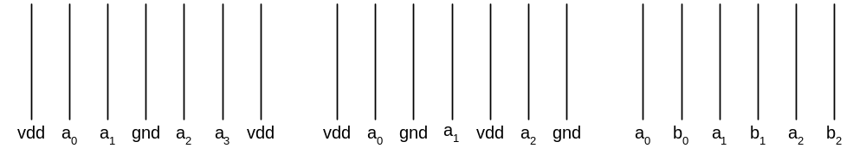
Wire Engineering
Goal: achieve delay, area, power goals with acceptable noise
Degrees of freedom:
  Width
  Spacing
  Layer
  Shielding

Slide 29
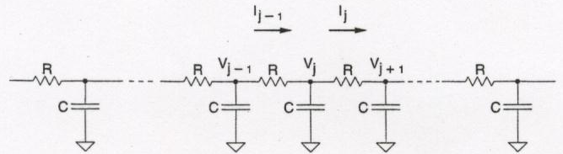
Distributed RC Effects
Signal propagation along wire influenced by:
  Distributed R
  Distributed C
  Impedance of driver
  Impedance of load
Transmission line effect – very bad for poly, polysilicide, diffusion, and heavily-loaded metal wires
Dominate for long wires

Slide 30
Wire Delay Equations
C d Vj = (I_{j-1} - I_{j})
d t
= (V_{j-1} – V_{j}) -- (V_{j} – V_{j+1})
R R
Make # wire sections large – reduce to differential form (using a diffusion equation)
r c d V = d² V
d t d x²
x = distance from input
r = resistance / unit length
c = capacitance / unit length

Slide 31
Delay Equations
t_{x} = k x² form, t_{x} is propagation time
From discrete analysis:
t_{n} = RC n (n + 1) , n = # wire sections
2
In the limit as n
t₁ = r c l ²
2
l = wire length

Slide 32
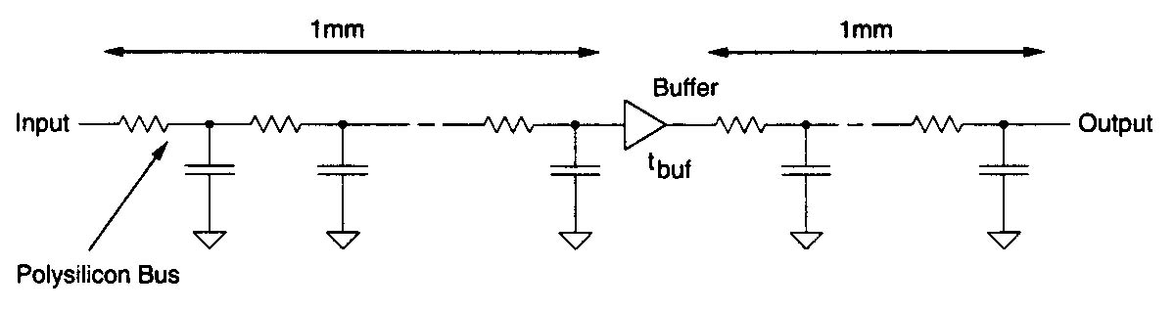
Insert Buffer into Long Wire

Slide 33
Example
2 mm wire with buffer of delay τ_{buf}
t_{p} = propagation delay, r = 20 Ω / μm
c = 4 X 10⁻⁴ pF / μm, r c / 2 = 4 X 10⁻¹⁵ sec / μm²
With buffer:
t_{p} = 4 X 10⁻¹⁵ (1000)² + τ_{buf} + 4 X 10⁻¹⁵ (1000)²
= 8 nsec + τ_{buf}
No buffer:
t_{p} = 4 X 10⁻¹⁵ (2000)² = 16 nsec
Keep τ_{buf} small (a buffer is 2 cascaded inverters)
Segmented bus with buffers can be much faster than unbuffered bus

Slide 34
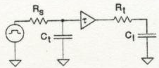
Lumped Model for Buffer
τ_{buf} depends on R of 1st bus section and C of 2nd bus section
Used to calculate τ_{buf}
Where do we worry about this?
  Used to be RAM polysilicide word lines
  Metal clock lines with heavy load
  Now worry about this on all long wires

Slide 35
Repeaters
R and C are proportional to l
RC delay is proportional to l²
  Unacceptably great for long wires

Slide 36
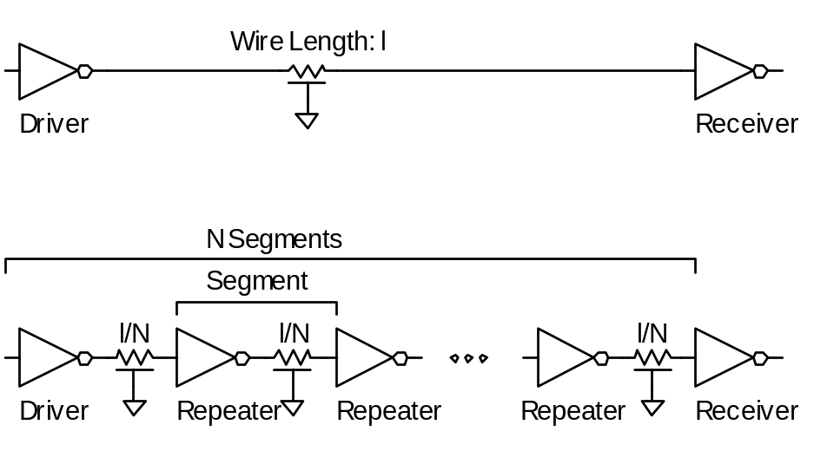
Repeaters
R and C are proportional to l
RC delay is proportional to l²
  Unacceptably great for long wires
Break long wires into N shorter segments
  Drive each one with an inverter or buffer

Slide 37
Repeater Design
How many repeaters should we use?
How large should each one be?
Equivalent Circuit
  Wire length l/N
    Wire Capaitance C_{w}*l/N, Resistance R_{w}*l/N
  Inverter width W (nMOS = W, pMOS = 2W)
    Gate Capacitance C’*W, Resistance R/W

Slide 38
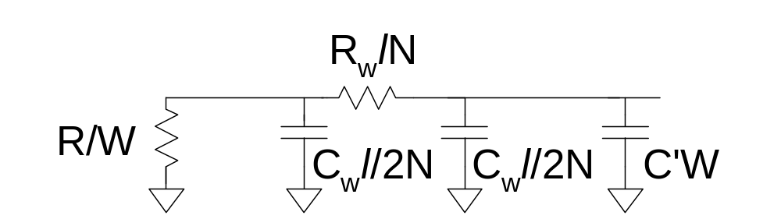
Repeater Design
How many repeaters should we use?
How large should each one be?
Equivalent Circuit
  Wire length l
    Wire Capacitance C_{w}*l, Resistance R_{w}*l
  Inverter width W (nMOS = W, pMOS = 2W)
    Gate Capacitance C’*W, Resistance R/W

Slide 39
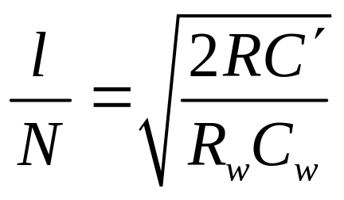
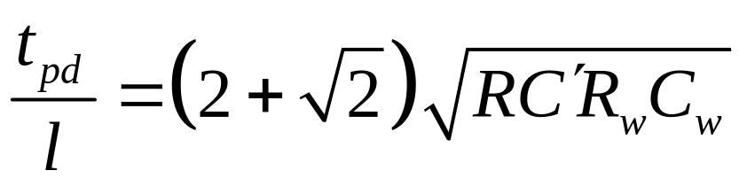
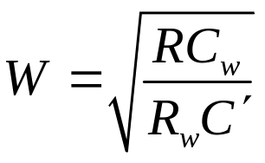
Repeater Results
Write equation for Elmore Delay
  Differentiate with respect to W and N
  Set equal to 0, solve
~60-80 ps/mm
in 180 nm process

Slide 40
Summary
Introduction
Wire Resistance
Wire Capacitance
Wire RC Delay
  Resistance – important for correct delay calculation
  Capacitance – critical for correct delay calculation
  Distributed RC Effects – critical for all long wires
Wire Engineering
Repeaters

